Slide 1
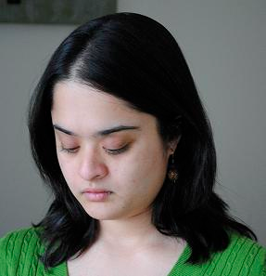


Unsupervised Learning of Hierarchical Spatial Structures
Devi Parikh, Larry Zitnick and Tsuhan Chen

Slide 2
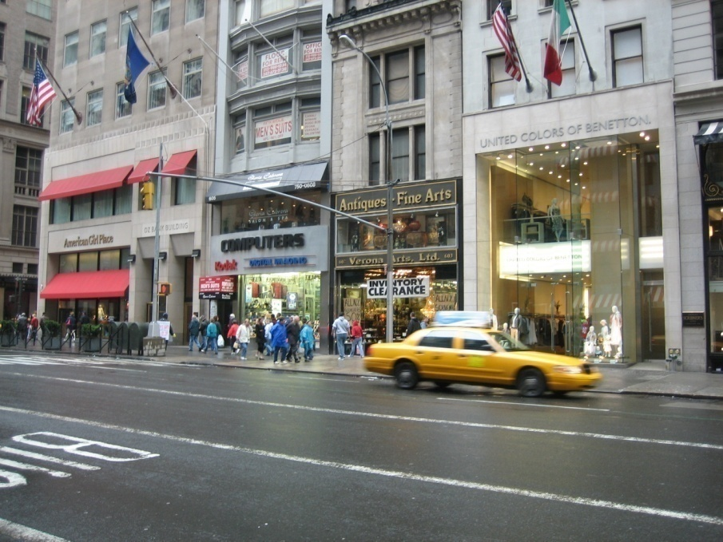
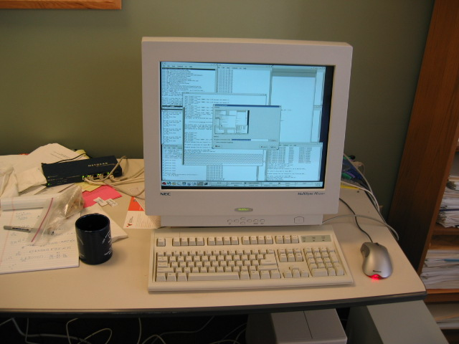
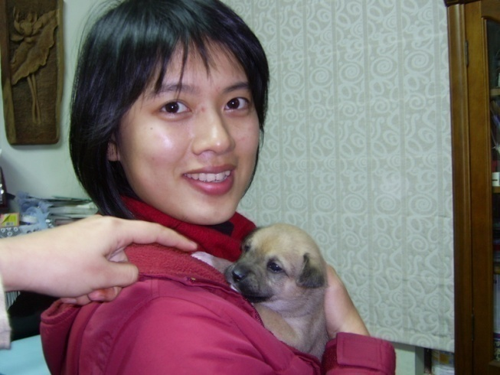
Our visual world…
Intro
Approach
Results
Conclusion
What is an object?
What is context?
… hierarchical spatial patterns
Notes:
What are objects? What is context?

Slide 3
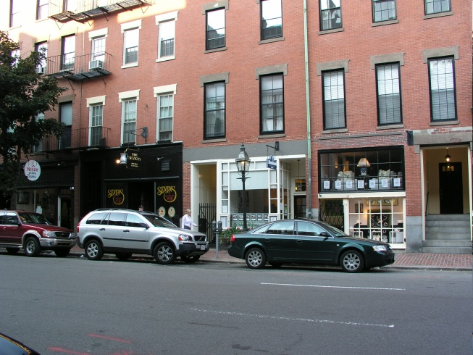

Goal
Intro
Approach
Results
Conclusion
Unsupervised!
Notes:
Seemingly different.. People have used it for different things.. But all manifestations of different levels in the hierarchy
Such an hierarchy would be useful – for all these tasks – but can’t learn supervised – so unsupervised

Slide 4
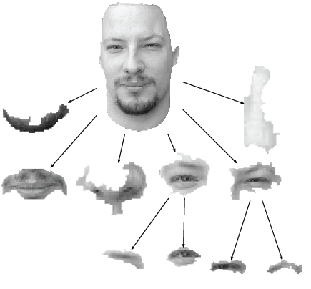
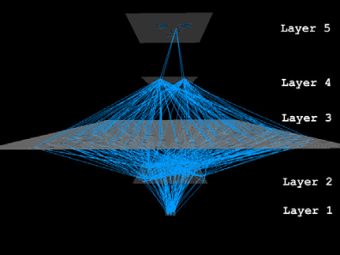
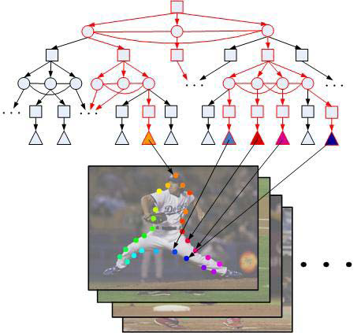
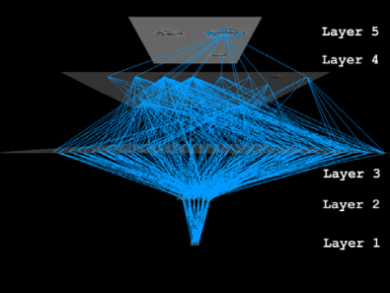
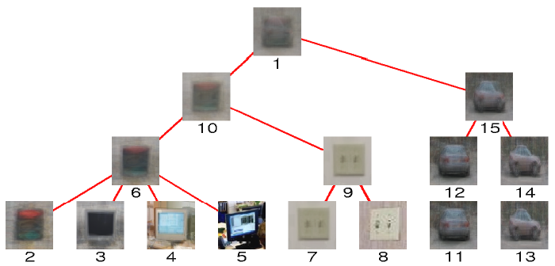
Related work
Intro
Approach
Results
Conclusion
[Todorovic 2008]
[Fidler 2007]
[Zhu 2008]
Fully unsupervised
Structure and parameters learnt
From features to multiple objects
[Sivic 2008]
Notes:
Ours:
Features to multiple objects
Completely unsupervised
Structure and parameters all learnt – different for different images

Slide 5
Model
Intro
Approach
Results
Conclusion
Rule based
c₃
c₂
0.1
0.6
r₁
0.9
c₄
0.7
0.6
c₂
c₁

Slide 6
Model
Intro
Approach
Results
Conclusion
Rule based
c₃
c₂
0.1
0.6
r₁
0.9
r₂
0.7
0.6
c₂
c₁

Slide 7
Model
Intro
Approach
Results
Conclusion
Hierarchical rule-based
c₃
c₂
0.1
0.6
r₁
0.9
r₂
0.7
0.6
c₂
c₁

Slide 8
Model
Intro
Approach
Results
Conclusion
Codewords C
Features F
Rules R
Image-parts V

Slide 9
Model
Intro
Approach
Results
Conclusion
Notation
V = {v} instantiated image-parts
r_{v} rule corresponding to instantiated part v
Ch(r_{v}) = {x} children of rule r_{v}
→ includes instantiated children Ch(v)
→ and un-instantiated children

Slide 10
Model
Intro
Approach
Results
Conclusion

Slide 11
Inference
Intro
Approach
Results
Conclusion

Slide 12
Inference
Intro
Approach
Results
Conclusion

Slide 13
Inference
Intro
Approach
Results
Conclusion

Slide 14
Inference
Intro
Approach
Results
Conclusion

Slide 15
Inference
Intro
Approach
Results
Conclusion

Slide 16
Inference
Intro
Approach
Results
Conclusion

Slide 17
Inference
Intro
Approach
Results
Conclusion

Slide 18
Inference
Intro
Approach
Results
Conclusion

Slide 19
Inference
Intro
Approach
Results
Conclusion

Slide 20
Inference
Intro
Approach
Results
Conclusion

Slide 21
Inference
Intro
Approach
Results
Conclusion
Minimum Cost Steiner Tree
Charikar 1998

Slide 22
Inference
Intro
Approach
Results
Conclusion

Slide 23
Inference
Intro
Approach
Results
Conclusion
Generalized distance transform
Felzenszwalb et al. 2001

Slide 24
Learning
Intro
Approach
Results
Conclusion
EM style
Initialize rules
Infer rules
Update parameters
Modify rules

Slide 25
Learning
Intro
Approach
Results
Conclusion
Initialize rules
…

Slide 26
Learning
Intro
Approach
Results
Conclusion
Inference
…

Slide 27
Learning
Intro
Approach
Results
Conclusion
Inference
…

Slide 28
Learning
Intro
Approach
Results
Conclusion
Add children
…

Slide 29
Learning
Intro
Approach
Results
Conclusion
Add children
Update parameters
Pruning children
Removing rules
…
Notes:
Meanshift – drop cluster with few members
Multiple children with same appearance – two wheels of a motorbike

Slide 30
Learning
Intro
Approach
Results
Conclusion
Adding rules
Randomly add rules
…
…

Slide 31
Behavior
Intro
Approach
Results
Conclusion
Competition among rules
Competition with root (noise)

Slide 32
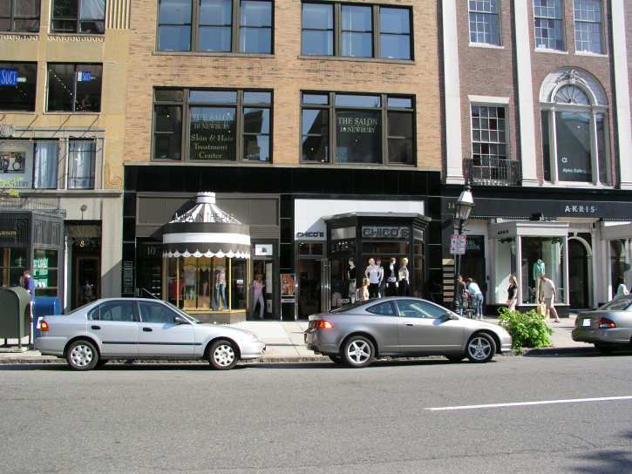
Behavior
Intro
Approach
Results
Conclusion
Competition among rules
Competition with root (noise)
Dropping children and rules
Number of children
Structure of DAG and tree
# rules, parameters, structure learnt automatically
Multiple instantiations of rules
Multiple children with same appearance

Slide 33
Experiment 1: Faces & Motorbikes
Intro
Approach
Results
Conclusion

Slide 34
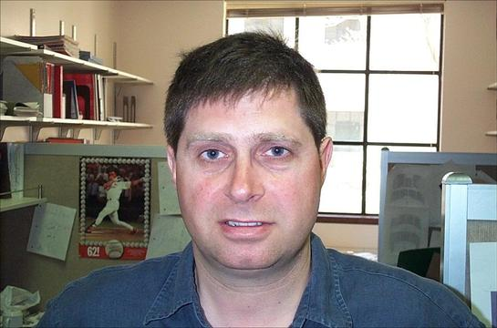
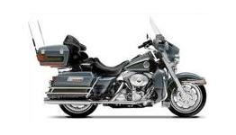
Faces & Motorbikes
Intro
Approach
Results
Conclusion
Faces and Motorbikes
SIFT (200 words)
Learnt 15 L1 rules, 2 L2 rules
Each L1 rule → average ~7 children
Each L2 rule → average ~4 children

Slide 35
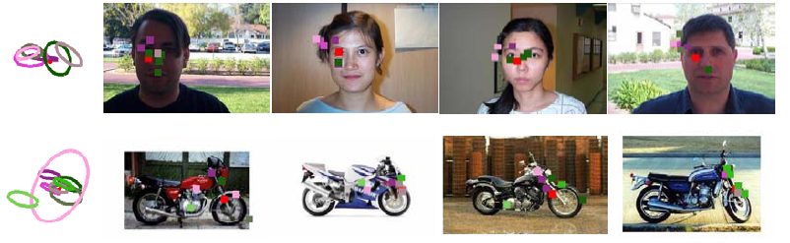
Example rules
Intro
Approach
Results
Conclusion

Slide 36
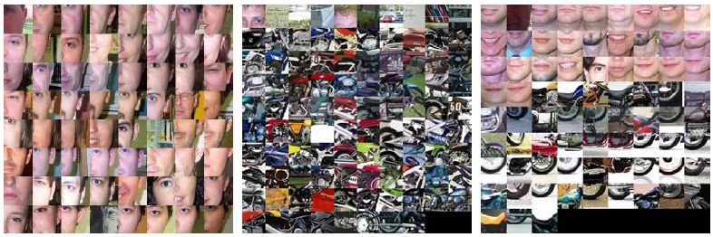
Patches
Intro
Approach
Results
Conclusion

Slide 37
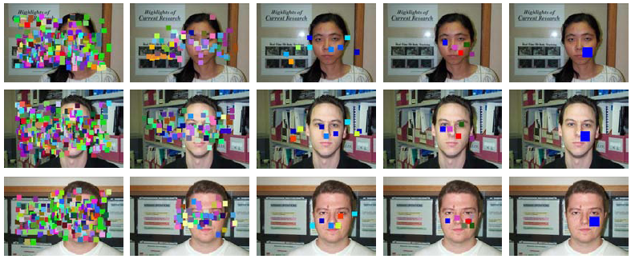
Localization behavior
Intro
Approach
Results
Conclusion

Slide 38

Categorization behavior
Intro
Approach
Results
Conclusion
code-words
first level rules
second level rules
occurrence
Faces
Motorbikes
Faces
Motorbikes
Faces
Motorbikes

Slide 39
Categorization behavior
Intro
Approach
Results
Conclusion
Kmeans
PLSA
SVM
Words
Rules
Tree
Words: 94 %
Tree: 100%

Slide 40
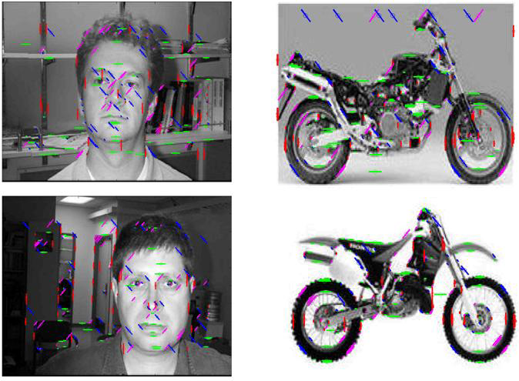
Edge features
Intro
Approach
Results
Conclusion
Words: 55 %
Tree: 82%

Slide 41
Experiment 2: Six categories
Intro
Approach
Results
Conclusion

Slide 42
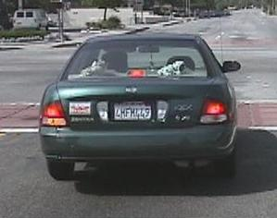
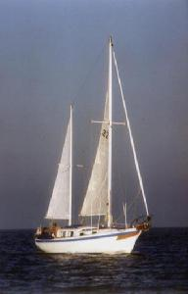
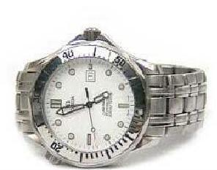
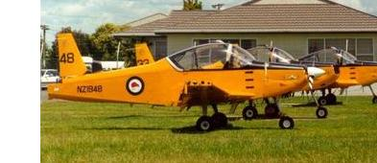
Six categories
Intro
Approach
Results
Conclusion
Words: 87 %
Tree: 95 %
61 L1 rules (~9 children)
12 L2 rules (~3 children)
Kim 2008: 95 %

Slide 43
Experiment 3: Scene categories
Intro
Approach
Results
Conclusion

Slide 44




Scene categories
Intro
Approach
Results
Conclusion
Image
Segmentation
Mean color
Codeword

Slide 45
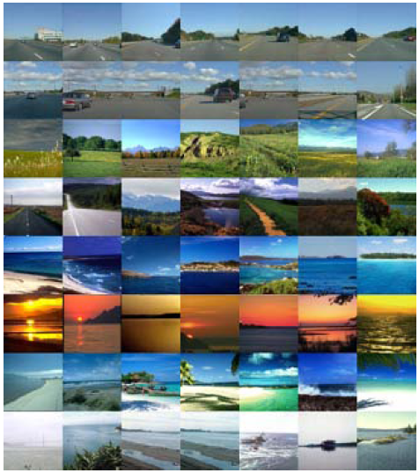
Outdoor scenes
Intro
Approach
Results
Conclusion
rules
images

Slide 46
Experiment 4: Structured street scenes
Intro
Approach
Results
Conclusion

Slide 47
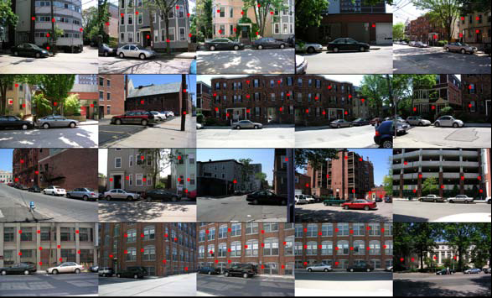
Windows
Intro
Approach
Results
Conclusion

Slide 48
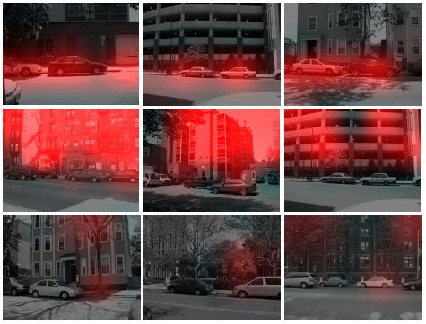
Object categories
Intro
Approach
Results
Conclusion

Slide 49
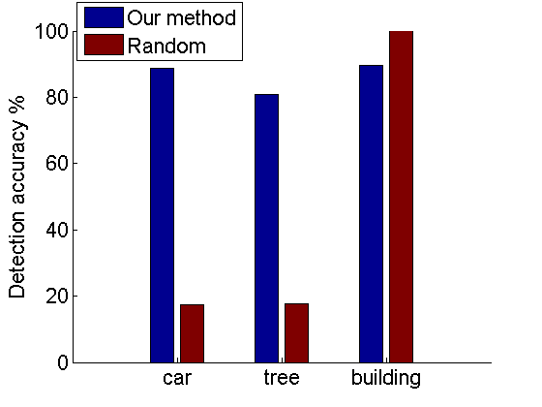
Object categories
Intro
Approach
Results
Conclusion

Slide 50
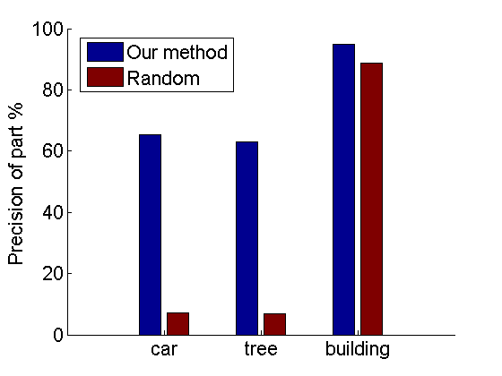
Object categories
Intro
Approach
Results
Conclusion

Slide 51
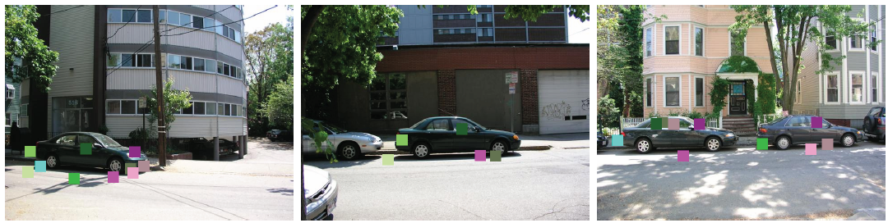
Parts of objects
Intro
Approach
Results
Conclusion

Slide 52
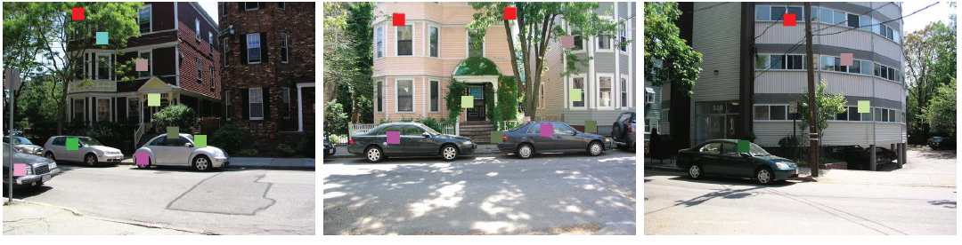
Multiple objects
Intro
Approach
Results
Conclusion

Slide 53
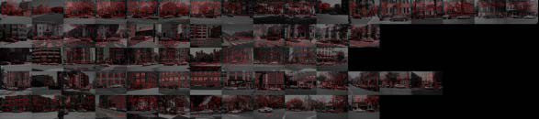
Street Scenes (PLSA)
Intro
Approach
Results
Conclusion

Slide 54
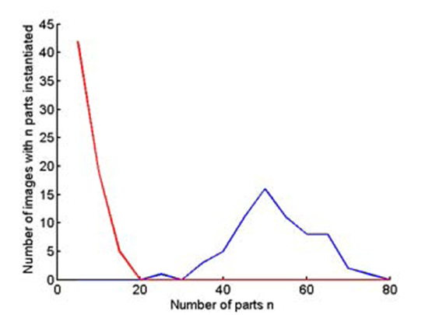
Dataset specific rules
Intro
Approach
Results
Conclusion
irrelevant
relevant

Slide 55
Conclusion
Intro
Approach
Results
Conclusion
Unsupervised learning of hierarchical spatial patterns
Low level features, object parts, objects, regions in scene
Rule-based approach
Learning: EM style
Inference: Minimum cost Steiner tree
Features
SIFT, edges, color segments

Slide 56
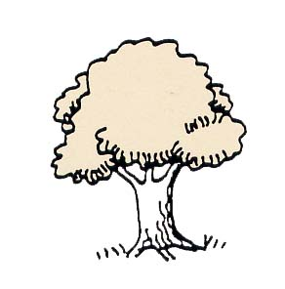
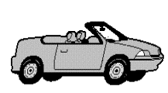
Summary
Intro
Approach
Results
Conclusion
Root
Scene
Objects
Object Parts
Features
I

